Slide 1
Disney | Stock Factor Analysis.
June 30, 2020

Slide 2
Agenda.
Question.
Analyses.
Summary.
What’s next?

Slide 3
Question.

Slide 4
Question.
What are some of the factors that affect the price of Walt Disney Company stock?

Slide 5

Why?
Walt Disney Company
The Walt Disney company is a diverse company that’s more than just an animated film producer.
We wanted to look at if a successful box office could affect the stock price along with other internal and external factors.

Slide 6
Analyses.

Slide 7
Analyses.
Newsworthiness.
Based on New York Times articles, does the number of articles per week represent the magnitude of change in the stock price?

Slide 8
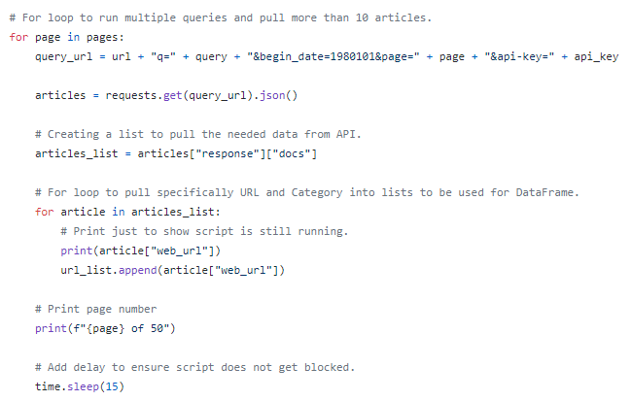
Data.
New York Times article API.
In order to pull the number articles per week, we had to create a looped python script that would request 50 pages (500 articles) from the Article Search API.

Slide 9
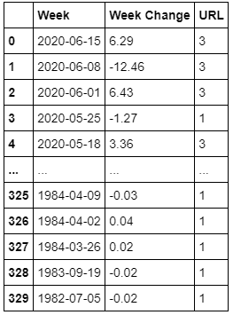
Data.
Combined data.
With historical stock price data, we were able to create a table that calculated the change in price during a specific week, along with the number of NYT articles based on publish date.

Slide 10
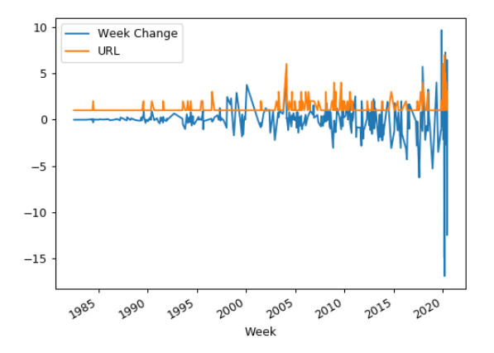
Data.
Plot.
With a quick eye test, we see occurrences of the two lines spiking together. Since we are just looking for change (positive or negative), anytime the article count spikes, we should see fluctuation with the stock price.

Slide 11
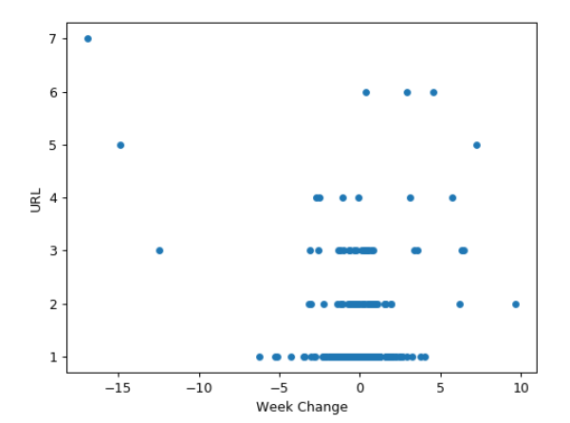
Data.
Plot again.
Using a scatter plot, we see that as we move higher up in article count, the more we see points move towards the sides, representing a large stock price change.

Slide 12
Data.
Relevant?
Insert chart for score.
Do the math calculations to see if there is correlation.

Slide 13
Summary.

Slide 14
Summary.
From the 5 factors we looked at, we determined # of them have a relationship with the stock price.

Slide 15
What’s next?

Slide 16
What’s next?
Look into more factors.
Connect the different factors.
Send to Walt Disney Company.
Become millionaires.

